Slide 1
Foundation, a CSS Framework
Joseph Meyer

Slide 2

What is Foundation?
“The most advanced responsive front-end framework in the world”
“It’s the first front-end framework created for developing fully responsive web apps.”

Slide 3

What is Foundation? (cont.)
“Foundation is made by Zurb, a product design company in Cambell, California. We’ve put more than 15 years of experience building web products, services and websites into this framework.”

Slide 4
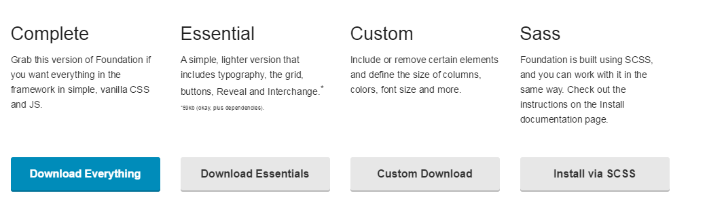



Downloading Foundation

Slide 5
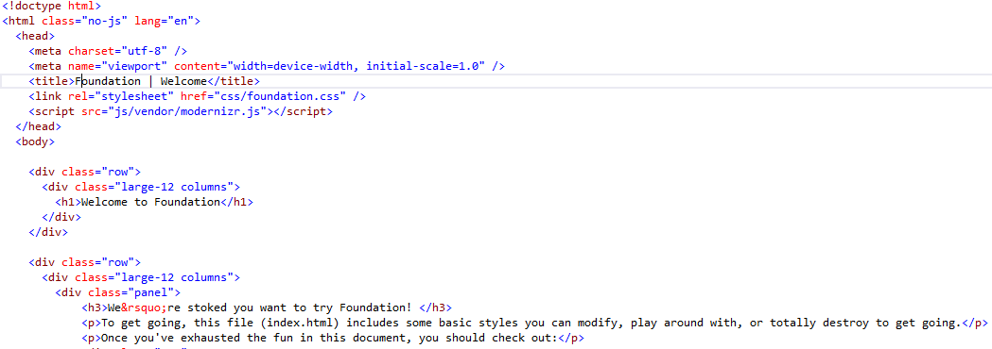

Downloading Foundation (cont).

Slide 6
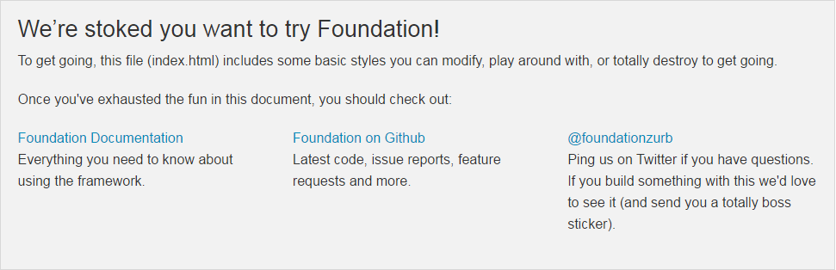
Downloading Foundation (cont).
Index.html page

Slide 7
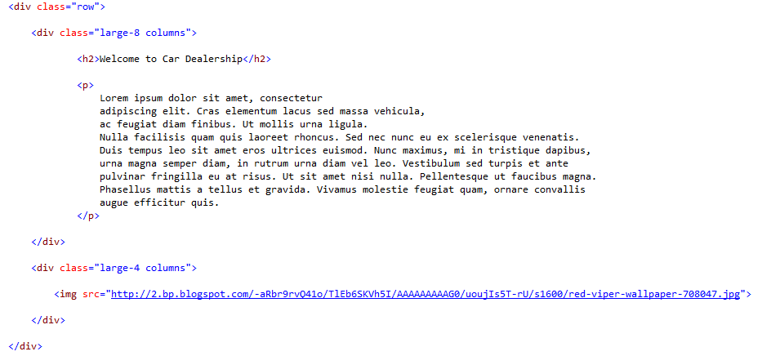

Building a Demo Application

Slide 8
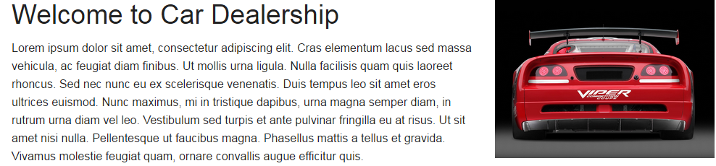
Demo cont.

Slide 9

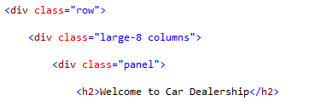
Demo cont.

Slide 10
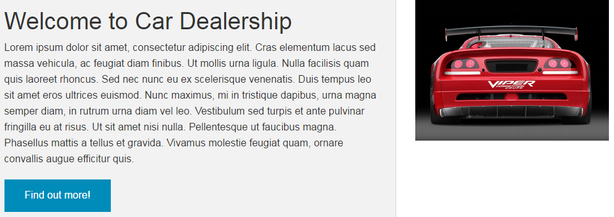
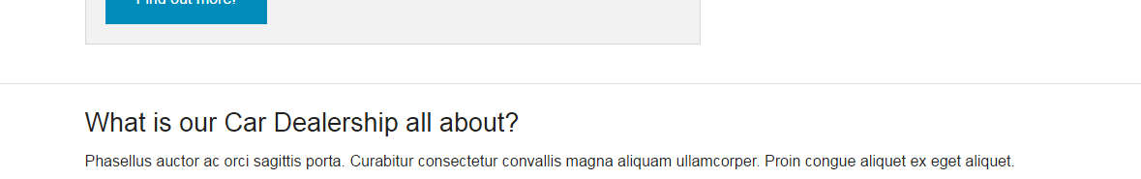
Demo cont.

Slide 11
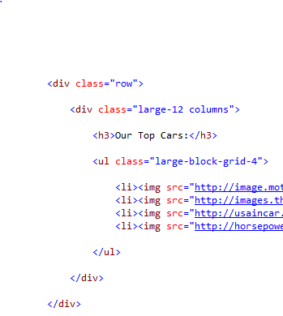
Demo cont.

Slide 12
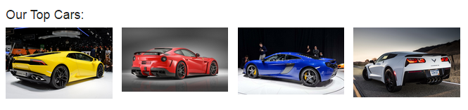
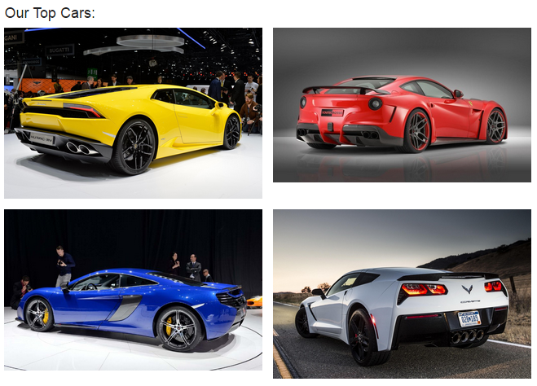
Demo cont.

Slide 13
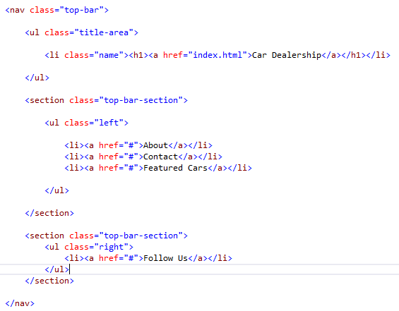
Demo cont.

Slide 14



Demo cont.

Slide 15
How is it different from Bootstrap?
Foundation was created from Zurb, not Twitter
  Zurb has a client list of eBay, Facebook, and NYSE
Foundation was the first to go responsive
Foundation was the first to be mobile first

Slide 16
How is it different from Bootstrap? (cont.)
Slightly different syntaxes
Foundation uses rems, while Bootstrap uses pixels
Foundation has Abide and Interchange features
Foundation has slightly different themes
  Goes away from the default Bootstrap look

Slide 17
How is it different from Bootstrap? (cont.)
Mobile design
  Foundation: “Anything not under a media query is going to be considered as mobile
  Bootstrap: “Should designers want to design for mobile, they’ll have to specify the media query for it”
Bootstrap has a bigger community
Can’t go wrong with either

Slide 18






Sites using Foundation
PBS, National Geographic, Mozilla, The Washington Post, Los Alamos, Felix

Slide 19

Sources (list them)
http://www.google.com
http://foundation.zurb.com/
https://yt3.ggpht.com/-8meSrLqfKbk/AAAAAAAAAAI/AAAAAAAAAAA/QnZgC6Vhlgc/s900-c-k-no/photo.jpg
http://assets.uxbooth.com/uploads/2010/04/zurb-logo-large.png
http://images.nationalgeographic.com/wpf/sites/common/i/presentation/NGLogo560x430.png
http://www.h3dwallpapers.com/wp-content/uploads/2014/08/Mozilla_logo-3.jpg
http://greatestamericanhotdogs.com/wp-content/uploads/2012/10/Washington-Post.jpg
http://www.lanl.gov/_assets/images/lanl-logo-footer.png
https://tctechcrunch2011.files.wordpress.com/2012/04/felix-color-logo-300dpi3.png?w=400
https://bootstrapbay.com/blog/bootstrap-vs-foundation/
http://stackoverflow.com/questions/11799236/should-i-use-px-or-rem-value-units-in-my-css
https://www.youtube.com/watch?v=kAAhtJtNq_M

